Slide 1


01
15
CLIMATE CHANGE AND CASH HOLDINGS ADJUSTMENT SPEED: INTERNATIONAL EVIDENCE
NGUYEN HA PHUOC TRONG
Bachelor’s Student
Supervisor: Le Anh Tuan, Ph.D

Slide 2
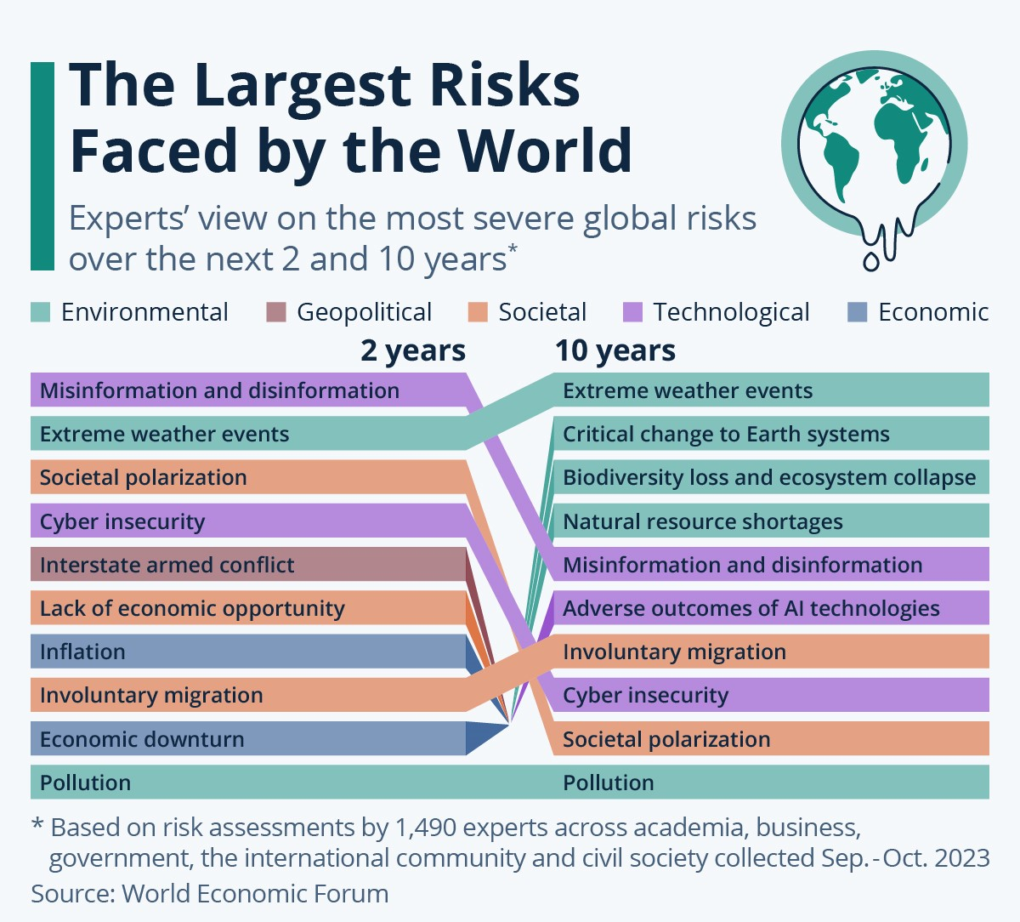
02
15
TABLE OF CONTENTS
INTRODUCTION
LITERATURE REVIEW
METHODOLOGY
RESULTS
CONCLUSION

Slide 3



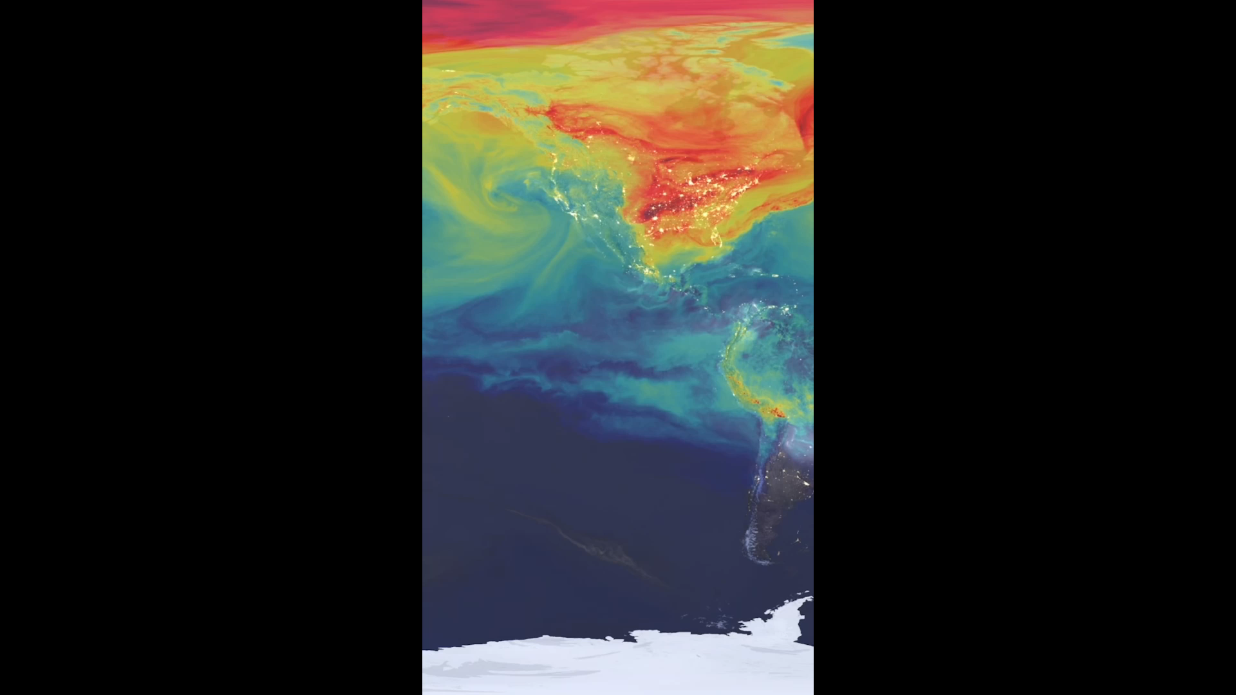
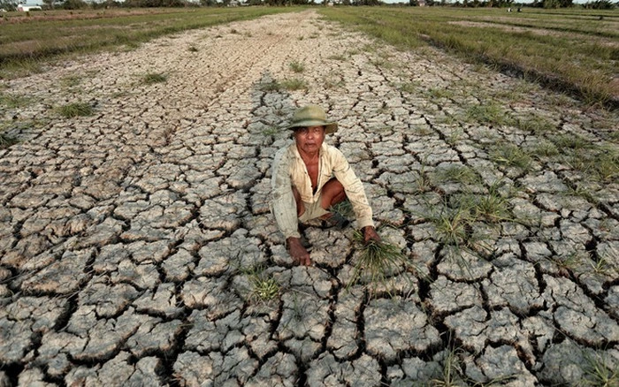
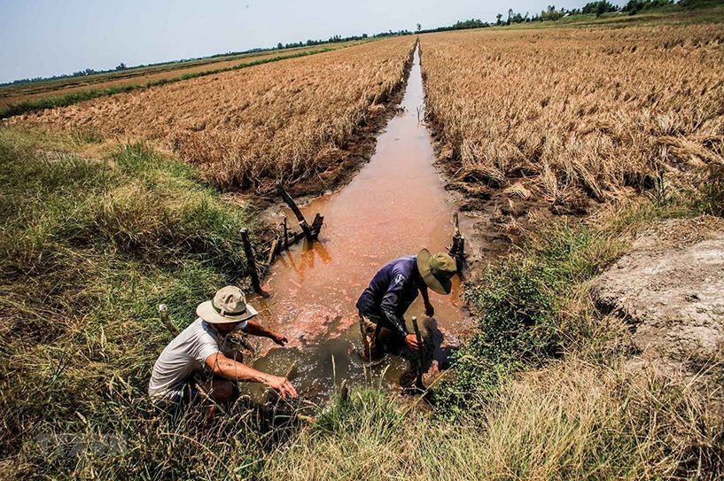
1. INTRODUCTION
03
15
Importance
Motivation
Contributions
Why climate change?
One of top risk and Top 1 in the next 10 years (WEF, 2024)
Temperature rises 4°C loss $23 trillion annually in the next 80 years (Kompas et al., 2018), etc.
Firm-level Climate change rather than Country-level climate change.
Explore the ways in which Climate Change and its risks influence corporate decision-making on a global scale, especially Cash holdings by approaching Dynamic trade-off theory and Dynamic partial adjustment model.
→ Filling these gaps by providing global evidence regarding the influence of Climate Change on the Speed of Cash holdings Adjustment.
Examine the differential effects of Climate Change on firms’ Cash holdings Adjustment Speed with cash deficits and cash surpluses.
Consider the impact of climate change on cash holdings adjustment speed under the role of Environmental Policy Stringency; and Financial Constraints.
Climate change is one of the severest pressing global concerns, increasing in recent years (Gounopoulos and Zhang, 2024)
The consequences of Climate change: Economic systems, Financial market, Corporate Financial Management.
The important role of corporations in using Cash holdings to combat Climate change and their behaviours.
Necessity of filling these gaps in existing literature.
Why cash holdings adjustment speed?
Cash holdings act as a financial buffer safeguard against uncertainties
Cash holdings sustain operations and maintain flexibility.
Offer protections against and limited access to external finance.
Dynamic partial adjustment model rather than Static model.
Research Question: Whether climate change affects the speed at which firms adjust their cash holdings, and if so, how does it impact this adjustment speed?; especially under financial and regulatory pressure?
Introduction
Literature review
Methodology
Results
Conclusion

Slide 4
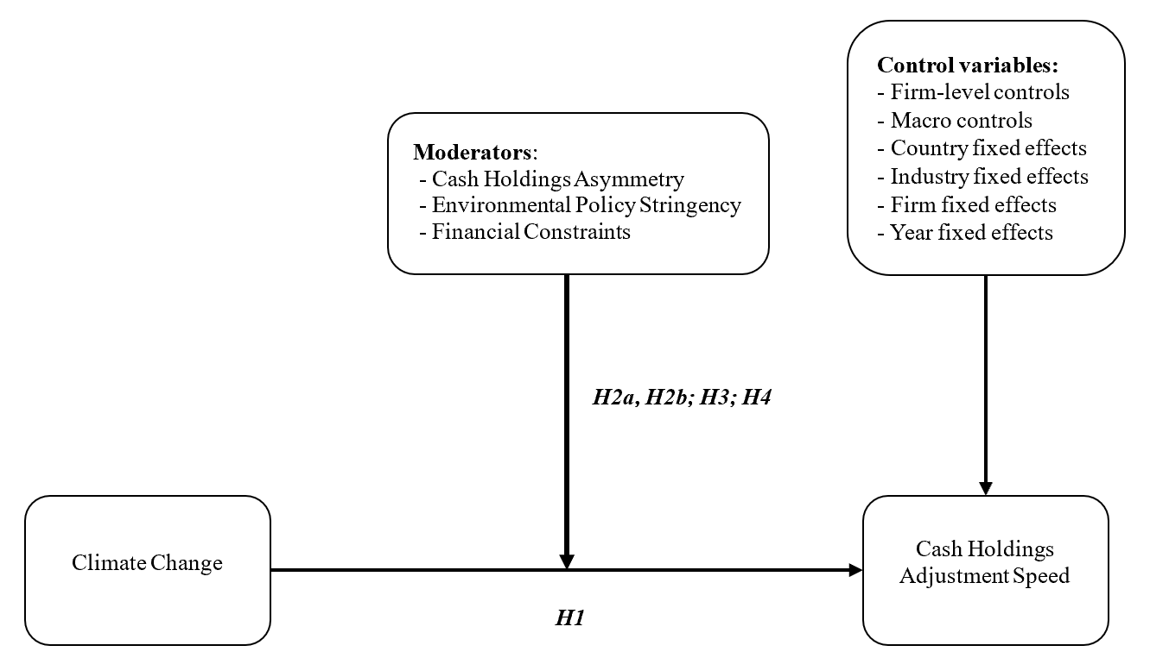
2. LITERATURE REVIEW
04
15
2. 2 Hypothesis development
2. 1 Fundamental theories
Theory about Cash holdings: trade-off theory, pecking order theory (financing hierarchy), agency theory, market timing theory,...
Hypothesis 1: Climate change is positively associated with cash holdings adjustment speeds.
Hypothesis 2a: The positive association between climate change and cash holdings adjustment speed is more pronounced when cash holdings are below their target level compared to when they are above the target level.
Hypothesis 2b: The positive association between climate change and cash holdings adjustment speed is more pronounced when cash holdings are above their target level compared to when they are below the target level.
Hypothesis 3: The positive relation between climate change and cash holdings adjustment speeds is more pronounced for firms in nations with higher environmental policy stringency.
Hypothesis 4: The positive relation between climate change and cash holdings adjustment speeds is more pronounced for firms with a higher degree of financial constraints.
Fundamental theory:
Trade-off theory: a target cash level - balance the costs and benefits .
Pecking order theory:
+ surpluses: hold more cash
+ deficits: use cash reserves
→ “two sides of the same coin ”
Precautionary savings motive: maintain liquid assets for unexpected contingencies and unforeseen shocks.
⇒ Climate change – future uncertainties and potential financial distress – holding cash – costs of deviating, costs of adjustment, and willingness (Jiang and Lie, 2016) – speed of adjustment.
Figure 1: Theoretical model
Introduction
Literature review
Methodology
Results
Conclusion

Slide 5
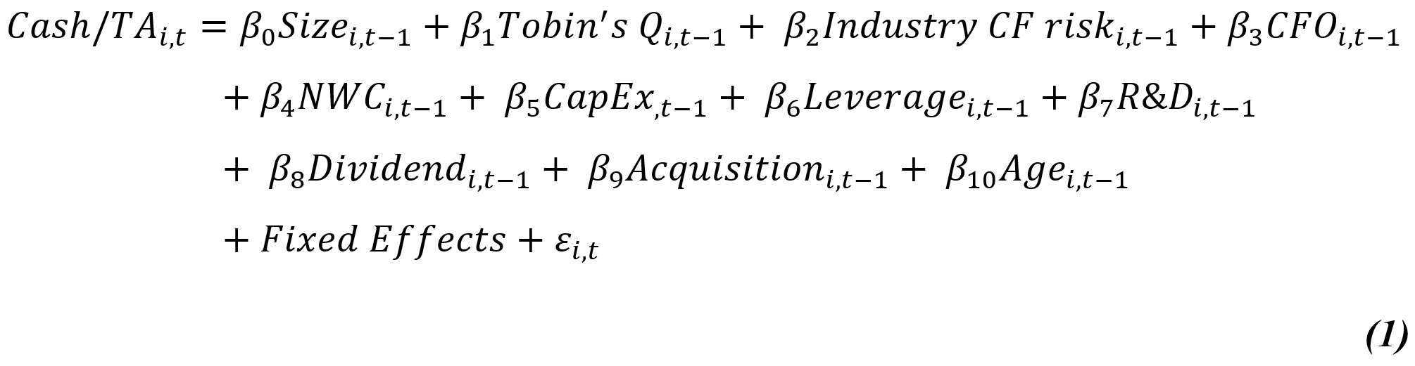
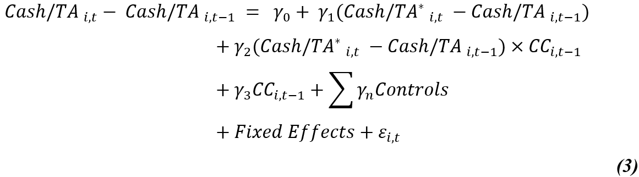
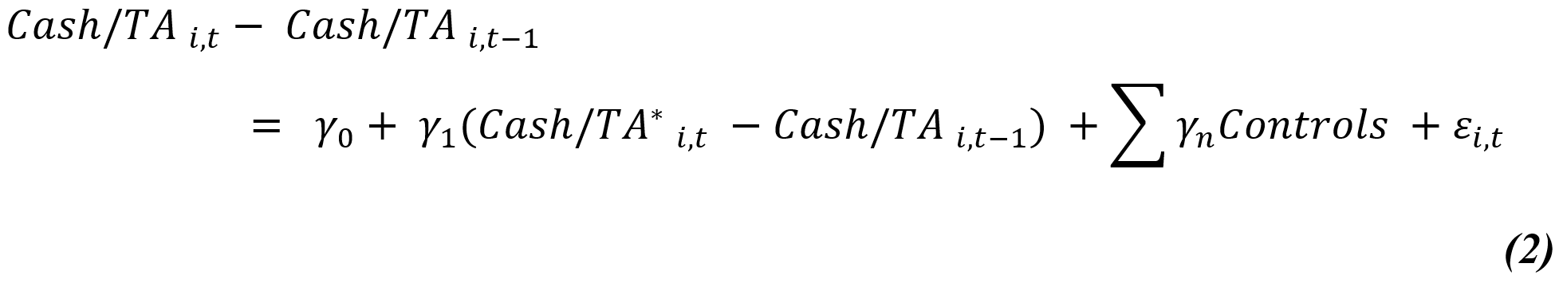
3. METHODOLOGY
05
15
3. 1 DATA SELECTION & BASELINE MODEL
Data:
Firm-level accounting data: Compustat US and Compustat Global.
Firm-level climate change: developed by Sautner et al. (2023)
Environmental policy stringency: OECD Data Explorer
Financial constraints: applied White-Wu Index (WWI)
Macro-control variable: World Bank’s World Development Indicators and World Bank Worldwide Governance Indicators
Empirical approach:
Identify Speed of Adjustment using Deviation from actual Cash following Partial Adjustment model.
Explore the relationship between Climate change and Cash holdings adjustment speeds by Fixed Effects OLS.
Employ System GMM, PSM estimation for endogeneity concerns.
Obtain Alternative measures and consider Overrepresentation for Robustness checks
Demonstrating the intensified Cash holdings adjustment speed under financial and regulatory pressure: Cash holdings asymmetry, Environmental policy stringency, Financial constraints.
Follow Opler et al. (1999), we build the Static adjustment model:
In line with Ozkan and Ozkan (2004), among others, we examine Climate change and Cash holdings adjustment speeds as follow:
Based on Lintner Model for Dividend policy, many researchers applied to develop the Dynamic partial adjustment model:
Sample:
31,766 observations over the period 2002-2019
4,787 unique firms worldwide across 49 countries
Introduction
Literature review
Methodology
Results
Conclusion

Slide 6
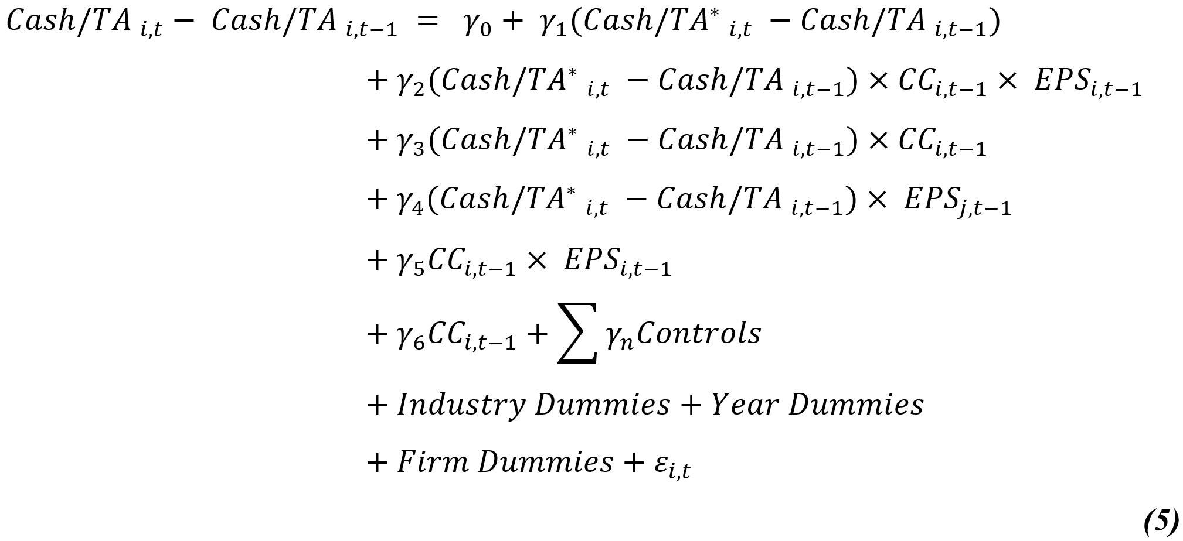
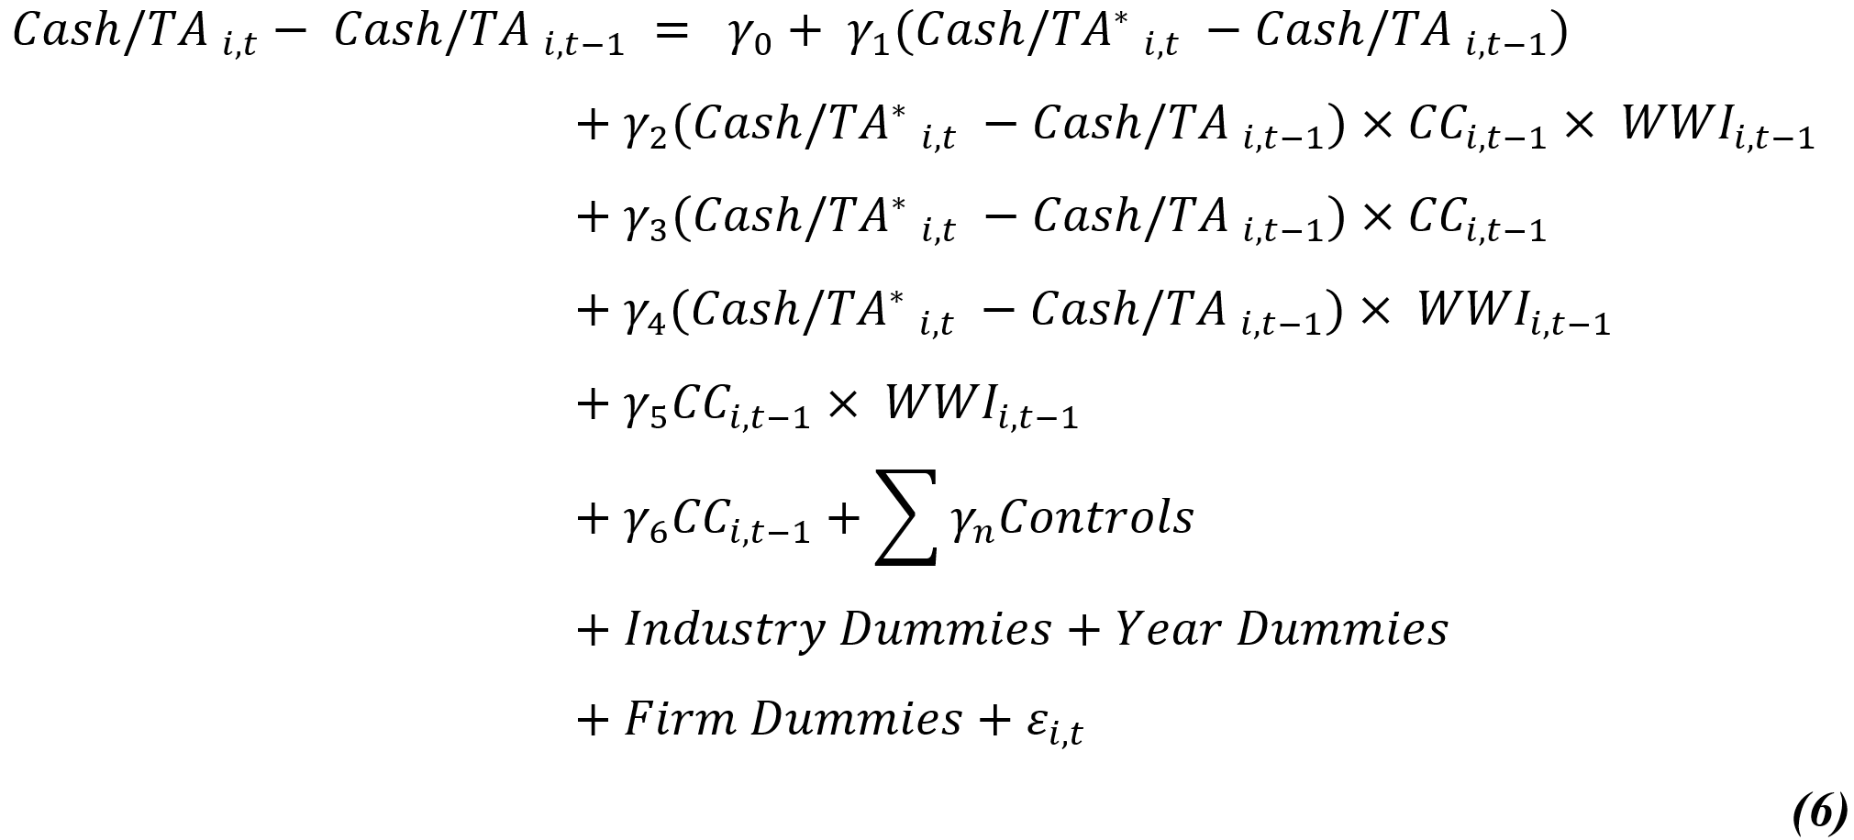
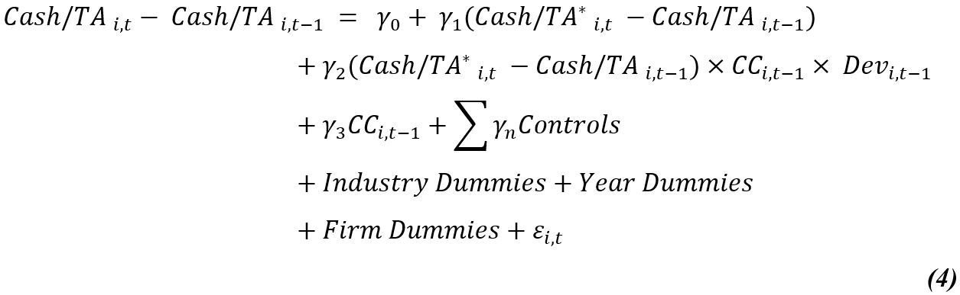
3. METHODOLOGY
06
15
3. 2 Interaction-term model
In spirit of Jiang and Lie (2016), we also investigate the Cash holdings asymmetry:
The role of Environmental Policy Stringency:
The role of Financial Constraints:
Introduction
Literature review
Methodology
Results
Conclusion

Slide 7
3. METHODOLOGY
07
15
3. 2 Variable definitions
Variable | Description | Sources
Climate change exposure (CCE) | The relative frequency of bigrams associated with climate change appearing in earnings conference call transcripts. | Constructed by Sautner et al. (2023)
Climate change risk (CCR) | The relative frequency of bigrams related to climate change that co-occur with the term’s "risk" or "uncertainty" (or their synonyms) within the same sentence in earnings conference call transcripts. | As above
Deviation from target Cash (DevCash) | The deviation from the target, defined as the gap between actual cash holdings and the target cash holdings level. | Seft-calculated as suggested in Ozkan and Ozkan (2004)
Cash/TA | The ratio of cash and cash equivalents to total assets. | Compustat Global database
Cash/NA | The ratio of cash and cash equivalents to net assets, where net assets are defined as total assets minus total liabilities. | As above
Size | The natural logarithm of total assets, normalised by the book value of total assets. | As above
Tobin’s Q | The ratio of enterprise value, calculated as (book value of total assets minus book value of equity plus market value of equity), to the book value of total assets. | As above
Industry CF risk (Industry) | The industry-level cash flow volatility, measured as the mean of the standard deviation of cash flow scaled by total assets over a 4-year period for firms within the same industry, as categorised by the two-digit SIC code. | As above
CFO | The ratio of earnings before depreciation, but after interest, dividends, and taxes, to the book value of total assets. | As above
NWC | The ratio of net working capital, excluding cash and equivalents, to the book value of total assets. | As above
CapEx | The ratio of capital expenditures to the book value of total assets. | As above
Leverage | The ratio of total debt to the book value of total assets. | As above
R&D | The ratio of research and development (R&D) expenditures to the book value of total assets. | As above
Dividend | A binary variable set to 1 if the firm paid a common dividend during the year, and 0 if it did not. | As above
Acquisition | A binary variable set to 1 if the firm undertook an acquisition during the year, and 0 otherwise. | As above
Age | The firm's age, measured as the number of years since the commencement of its operations. | As above
Inflation | The consumer price index (CPI), representing the annual percentage change in the cost to the average consumer of acquiring a standard basket of goods and services. | World Bank's World Development Indicators
GDP Growth | The natural logarithm of a country's gross domestic product (GDP) per capita. | As above
Corruption | The level of corruption, defined as the extent to which public power is exploited for private gain, encompassing both minor and major forms of corruption, as well as the undue influence or "capture" of the state by elites and private interests. | World Bank Worldwide Governance Indicators database.
High Financial Constraint | Firms are classified as having high financial constraints if they fall within the top tercile of the index, and as having low financial constraints if they fall within the bottom tercile. | Self-calculated following The Whited-Wu index (Whited & Wu, 2006)
High Stringent | Firms in the top tercile of the EPS index are classified as highly stringent, while firms in the bottom tercile are classified as having low stringency. | OECD website
Introduction
Literature review
Methodology
Results
Conclusion

Slide 8
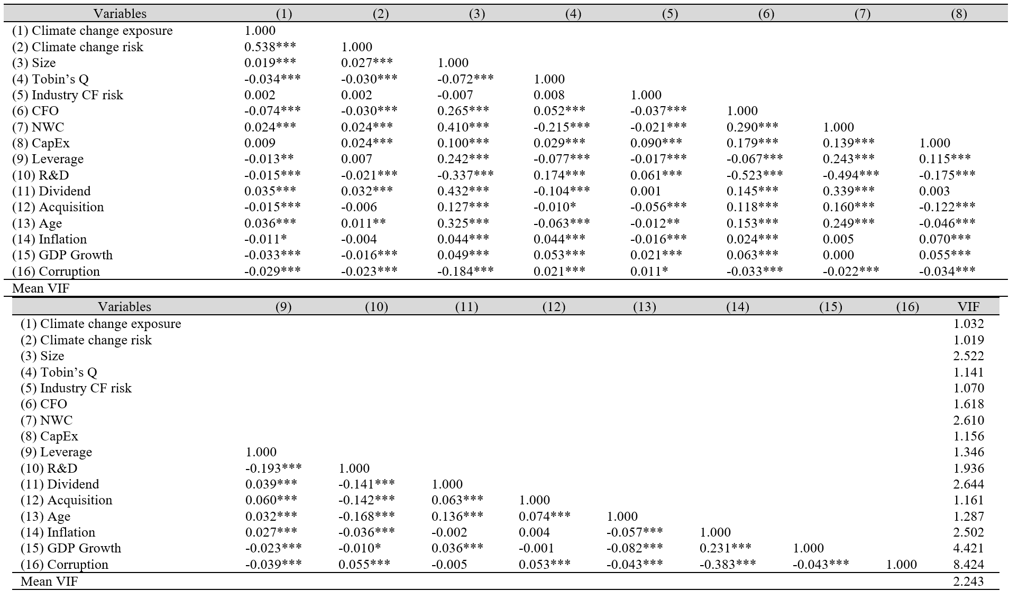
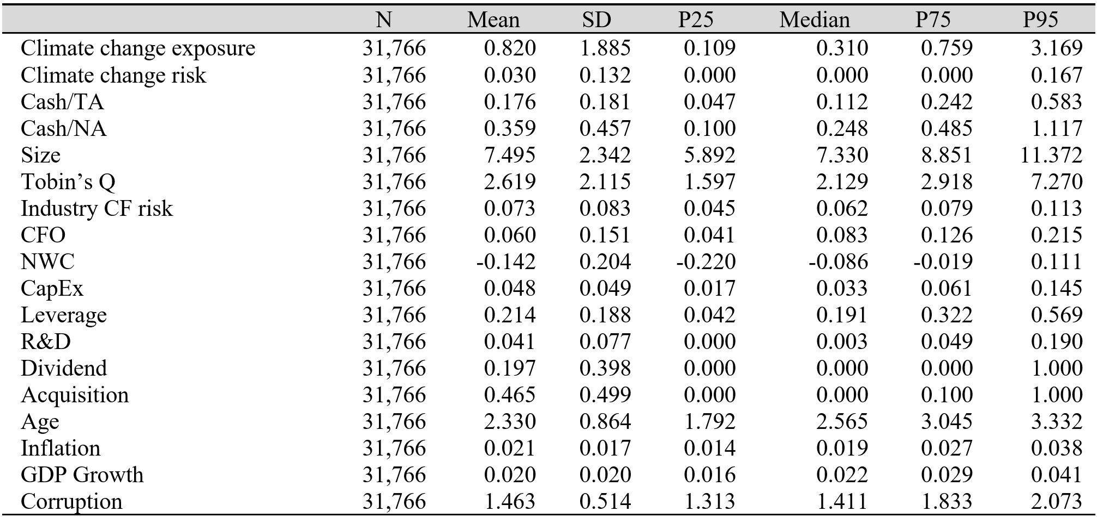
4. EMPIRICAL RESULT
08
15
4. 1 Descriptive statistics
Table 1: Descriptive statistics
Table 2: Pairwise correlation
Introduction
Literature review
Methodology
Results
Conclusion

Slide 9
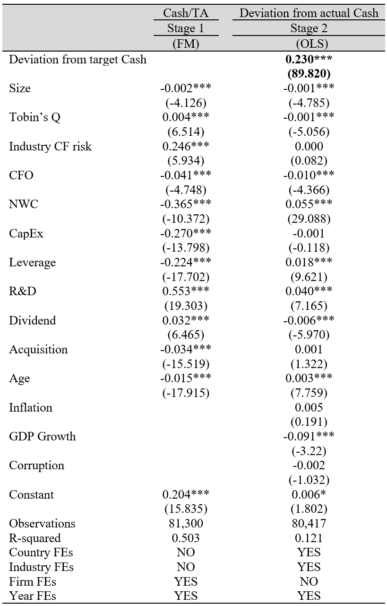
4. EMPIRICAL RESULTS
09
15
4. 2 Cash holdings adjustment speed
Findings:
All firm-level variables contribute to determine Cash Holdings.
Support the Trade-off theory and Partial adjustment model.
Firms tend to adjust gradually Cash Holding when deviating.
Table 3: Determinants and Dynamic partial adjustment model of Cash holdings
Introduction
Literature review
Methodology
Results
Conclusion

Slide 10
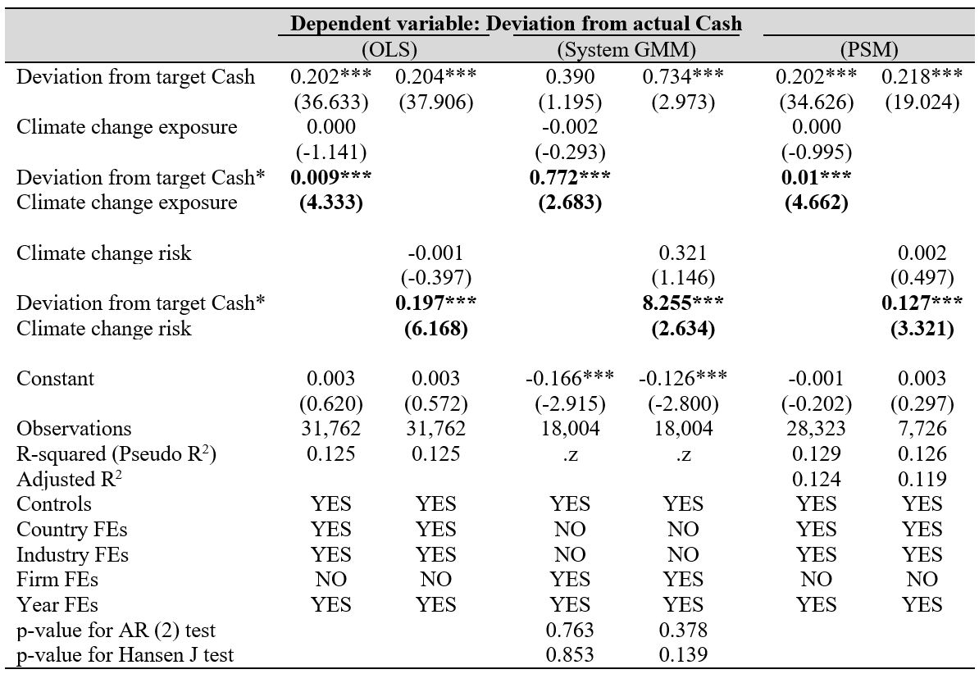
4. EMPIRICAL RESULTS
10
15
4. 3 Baseline - Endogeneity
Findings:
Climate change increase Firms’ Cash Holdings Adjustment Speed.
Endogeneity issues were controlled.
Support Hypothesis 1
Climate change is positively associated with cash holdings adjustment speeds.
Table 4: Baseline results and Endogeneity concerns
Introduction
Literature review
Methodology
Results
Conclusion

Slide 11
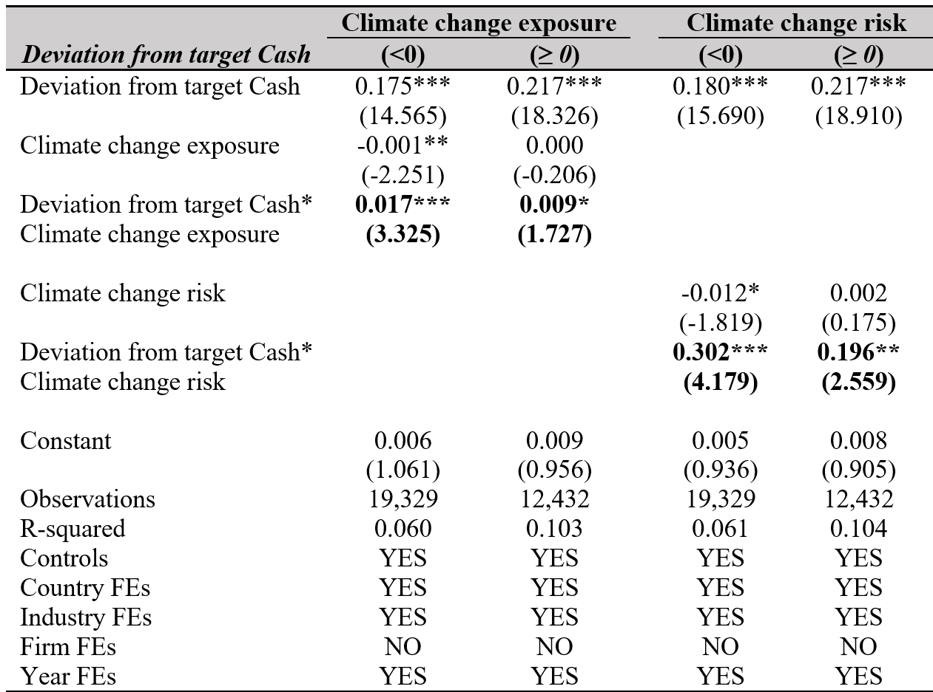
4. EMPIRICAL RESULTS
11
15
4. 4 Cross-sectional analysis
Findings:
Firms with cash deficits adjust faster their Cash Holdings compared to Firms with cash surpluses.
Support H2a and reject H2b
The positive association between climate change and cash holdings adjustment speed is more pronounced when cash holdings are below their target level compared to when they are above the target level.
Table 5: The Cash holdings asymmetry
Introduction
Literature review
Methodology
Results
Conclusion

Slide 12
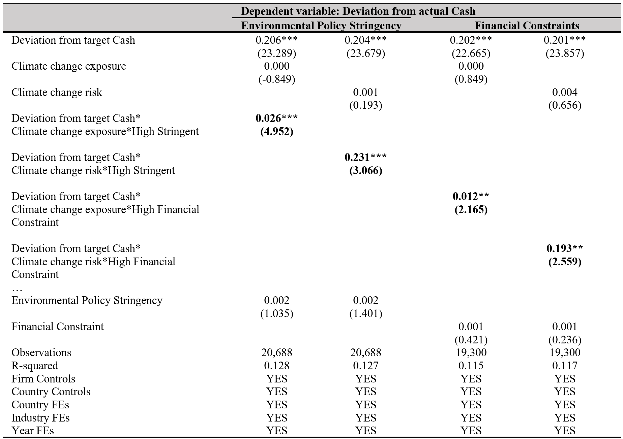
4. EMPIRICAL RESULTS
12
15
4. 4 Cross-sectional analysis
Findings:
Firms exposed to climate change faced intensively faster adjustments when influenced by both stricter environmental policies and greater financial constraints.
Support Hypothesis 3 and 4
The positive relation between climate change and cash holdings adjustment speeds is more pronounced for firms with a higher degree of financial constraints or in nations with higher environmental policy stringency.
Table 6: The role of Environmental policy stringency and Financial constraints
Introduction
Literature review
Methodology
Results
Conclusion

Slide 13
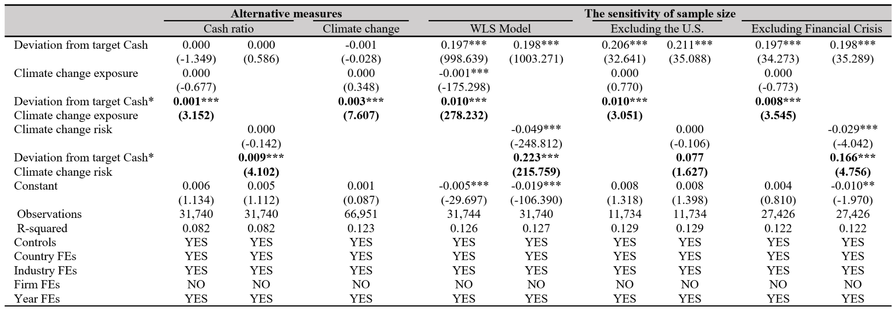
4. EMPIRICAL RESULTS
13
15
4. 5 Robustness checks
Table 6: Robustness checks by Alternative measures and Sensitivity of sample size.
Our findings remain consistent even after considering alternative measures of Climate change and the Cash ratio. Moreover, they are not influenced by overrepresentation in the sample.
Introduction
Literature review
Methodology
Results
Conclusion

Slide 14
5. CONCLUSION
14
15
Summary key findings:
Firms with larger deviations tend to accumulate cash faster to close the gap.
Climate change increases the Speed of Adjustment in Cash holdings.
Firms with cash deficits adjust cash level more rapidly than firms with cash surpluses.
Under Climate change conditions, Cash Holdings Adjustment Speed accelerates, with Environmental policy stringency and Financial constraints making this effect more pronounced.
Policy Implications:
Provide important insights for finance practitioners in devising strategies to curb effects of Climate change, by anticipating changes and managing resources in adjustment to minimise costs and maximise efficiency.
Policymakers' use of the delay from Partial adjustment model can affect decision-making processes, the timing of policy interventions, and the anticipation of their impacts related to climate change, leading to better regulations.
Understand how economic policies of Climate change should formulate and how their effects are anticipated on firms’ decision-making, especially cash holdings.
Limitations:
Our sample primarily consists of developed countries, with limited representation from developing economies, which could introduce bias in the results.
Further research could employ alternative methods to address endogeneity concerns, such as Difference-in-Differences or Two-Stage Least Squares, etc.
Our proxies may not fully capture the multifaceted and complex nature of climate change.
While we primarily examine firm-level management behaviours, broader factors like culture and societal trust, which might also affect cash holdings, are overlooked.
Introduction
Literature review
Methodology
Results
Conclusion

Slide 15

15
15
THANK YOU for you attention!
NGUYEN HA PHUOC TRONG
Mailing address
279 Nguyen Tri Phuong Str., Ward 5, District 10, HCMC
Phone number
(84) 359.726.854 – (84) 911.111.041
E-mail address
31211024239@student.isb.edu.vn

